Slide 1
Matrix Multiplication using Systolic Array
Abhipray Singh
Shreya Gulati
Chahak Tyagi
Aditya Kumar
Ganesh Bhagwat
Haoying Tan

Slide 2
Roles and Responsibilities
Team Lead and Design Lead- Abhipray Singh
Verification Lead - Ganesh Bhagwat
Physical Design Lead - Aditya Kumar

Slide 3
Introduction
Matrix multiplication is a compute-intensive operation which is widely used in image processing, data compression, and 3D graphics rendering.
By having dedicated hardware for this operation, we can speed up all of these applications.
Systolic arrays are one such approaches to realise this idea.

Slide 4
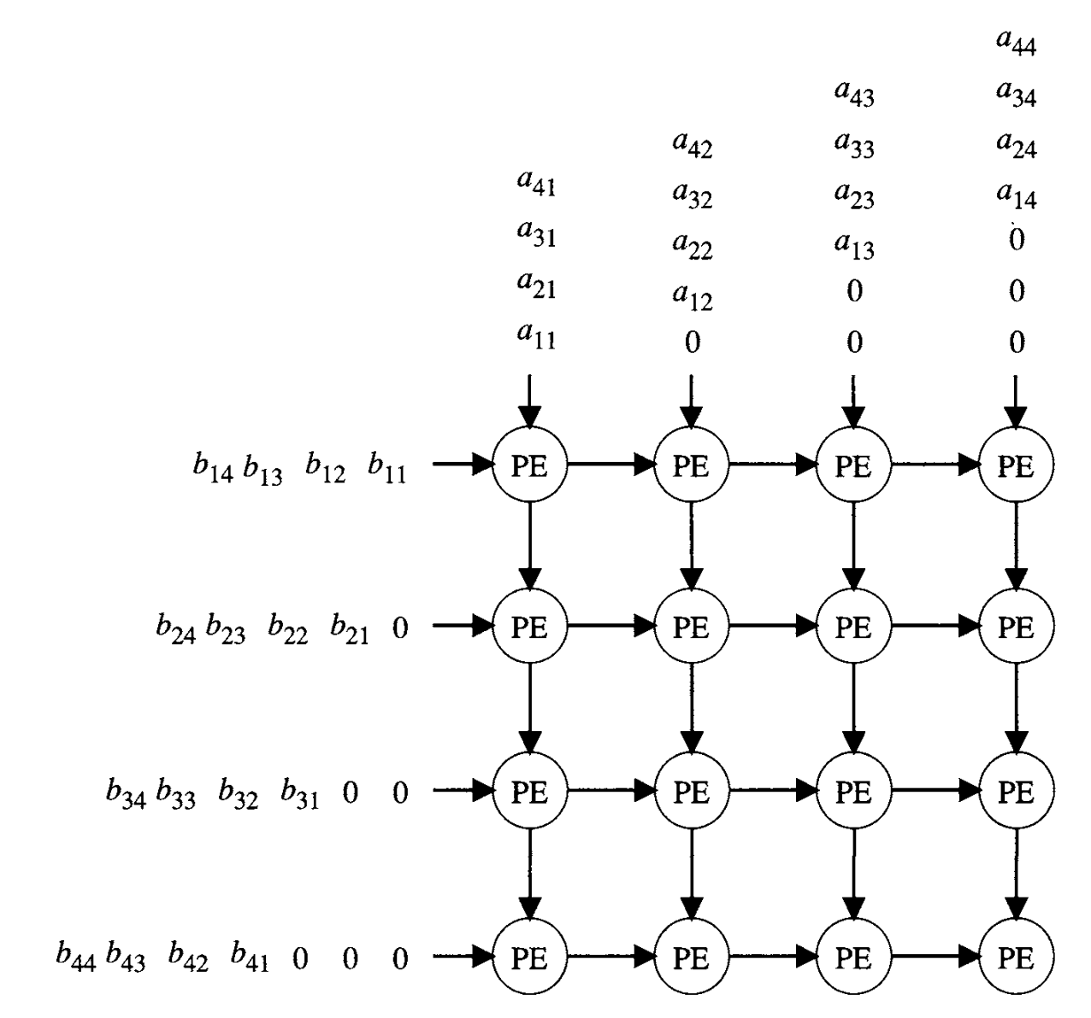
Systolic Array
A grid-like arrangement of simple processing elements that work in a synchronized manner.
Particularly effective in accelerating matrix multiplication operations.
We will initially focus on the implementation of systolic arrays for 4x4 matrix multiplication, and then extend to matrices of other sizes.
Lars Wanhammar, 8 - DSP Architectures, Editor(s): Lars Wanhammar, In Academic Press Series in Engineering, DSP Integrated Circuits, Academic Press, 1999, Pages 357-385, ISBN 9780127345307,https://doi.org/10.1016/B978-012734530-7/50008-8.

Slide 5

Systolic Array
https://www.youtube.com/watch?v=cmy7LBaWuZ8

Slide 6
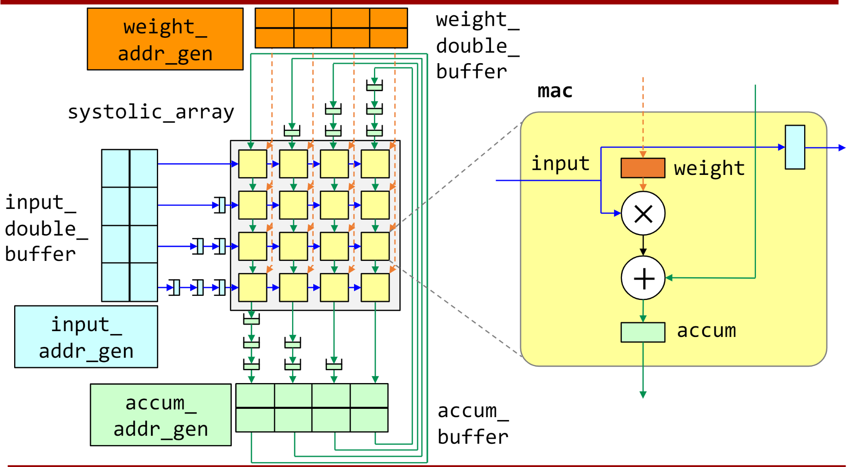

Slide 7
Our approach
Target is to implement a systolic array.
It is being exercised by implementing it with five stage in order pipeline.
Two approaches of data loading:
>> approach 1: load all matrices data in buffer before calculation commences
>> approach 2 : parallely load data and perform calculation to hide load latency
Plan is to arrange data memory in a 8 banked fashion.
This enables us to fetch all inputs from a single cache line , which enables us aligned fetch

Slide 8
Project Progression
Our first milestone is to have a working 4x4 systolic array that can do basic 4x4 matrix multiplication. This also serves as our fallback design in case future iteration fail.
Next , we develop the 5-stage pipeline and integrate with the systolic array and so we can use the instructions to control the array.
Finally, we plan to have a 5-stage pipeline systolic array that can perform any dimension of matrix multiplication like 4x1 * 1x4 , 2x4 * 4x2 etc.

Slide 9
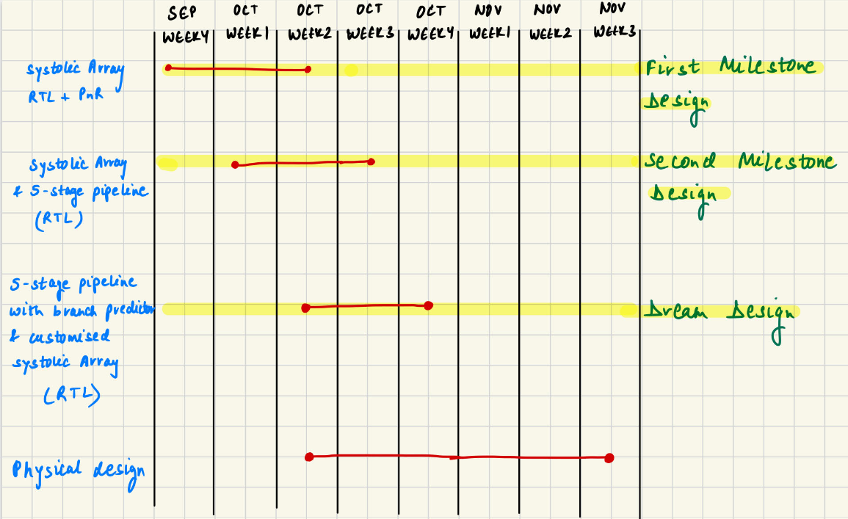
Project Plan

Slide 10
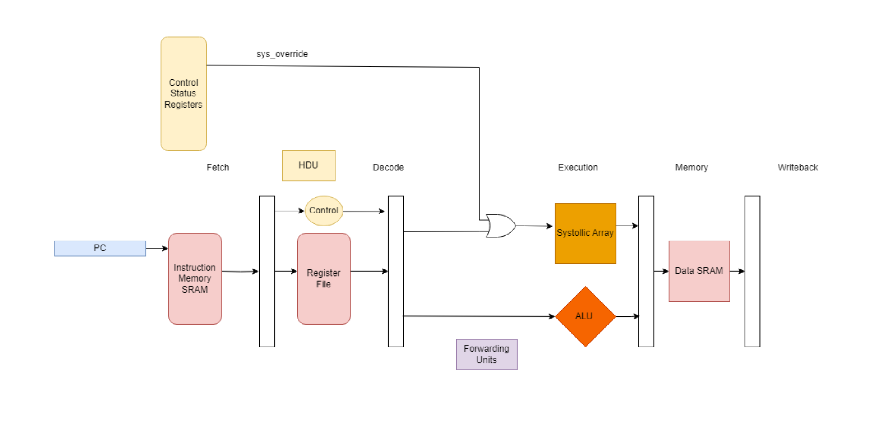
Proposed high-level block diagram

Slide 11
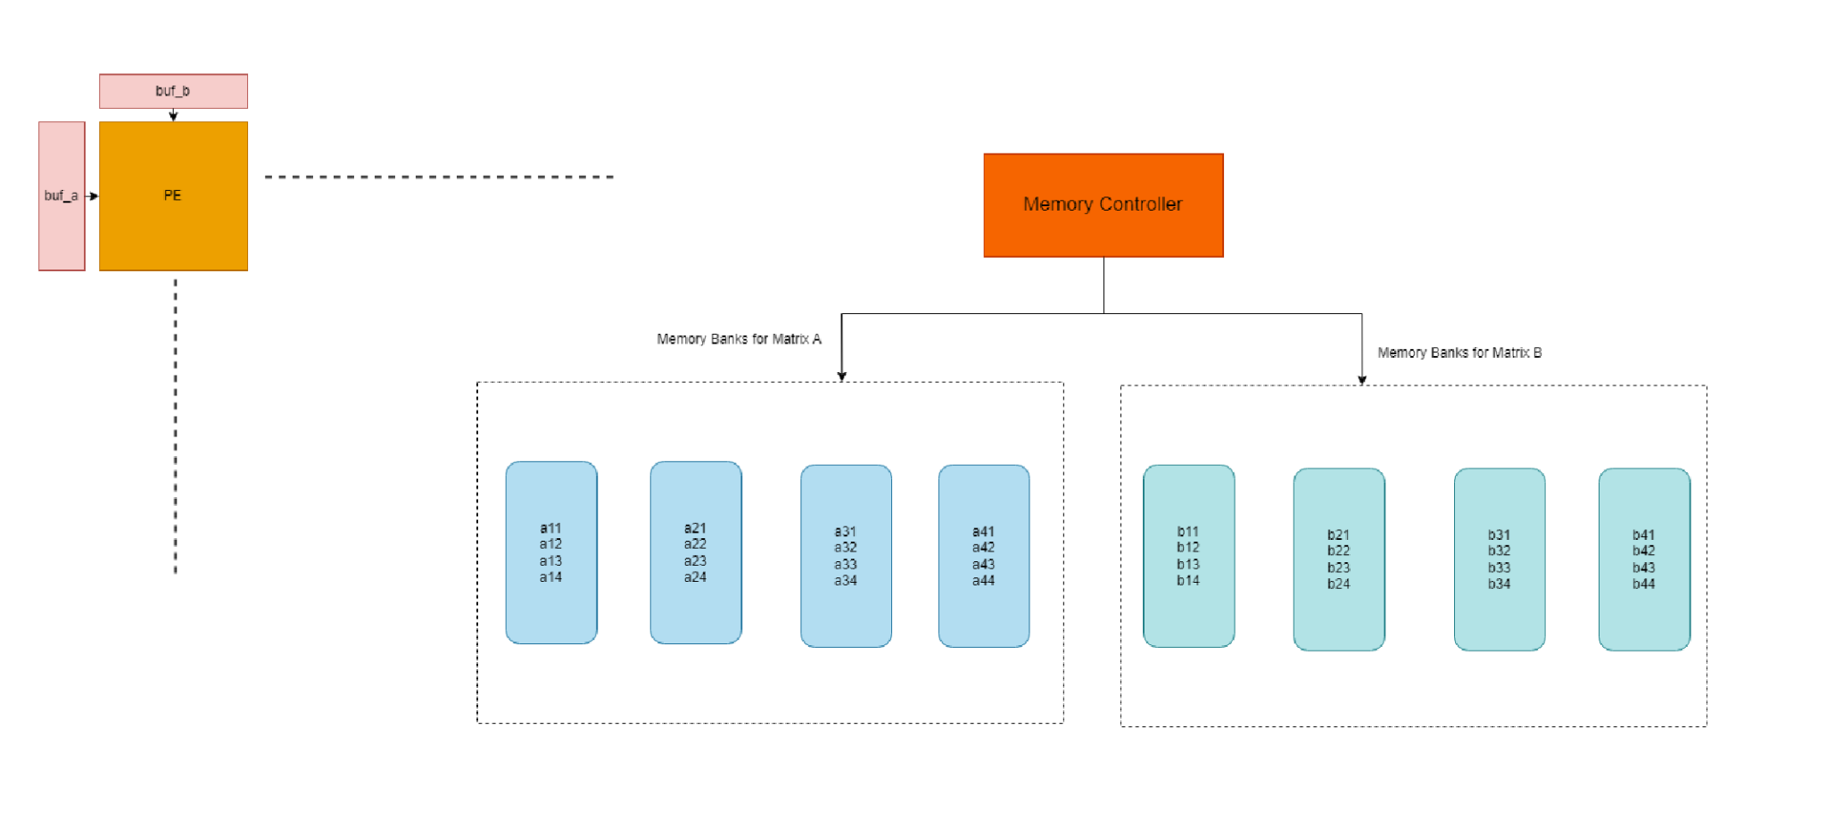
Proposed high-level block diagram

Slide 12
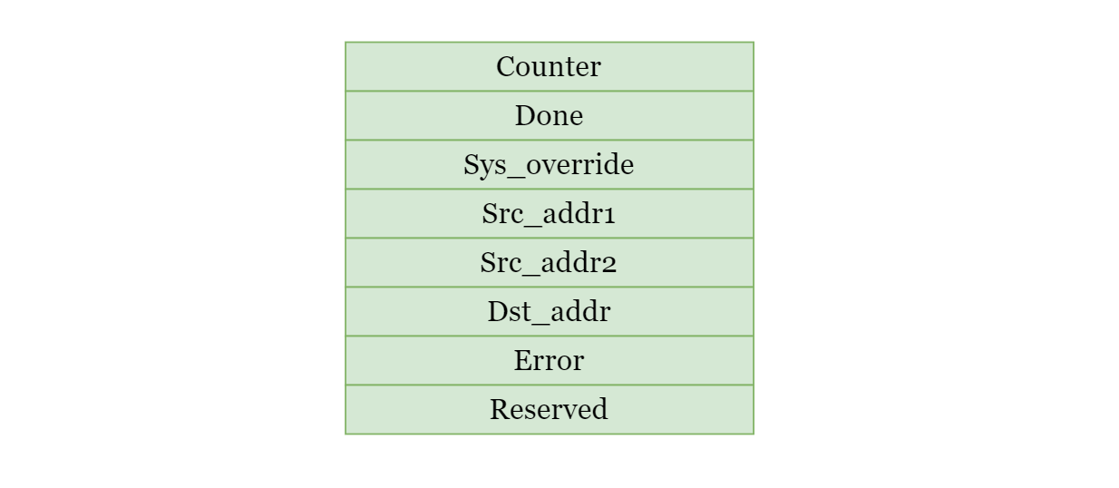
Control Status Register
Notes:
Done: Indicates that the matrix multiplication is complete Sys_override: This will override the instruction in the EX stage to executes matrix multiplication. This register helps in using the chip to multiply matrices even if the rest of the pipeline is broken!

Slide 13
Proposed Instructions
Add
Lw
Sw
Beq
jump
Sys dest_matrix_addr , source_1_addr , source_2_addr , size
store_counter - Write into memory number of cycles it took for computation
TBD

Slide 14
Future considerations
We start by supporting only the 4x4 multiplications, but we plan to support customizing the matrix dimensions.
Make the hardware do other operations, such as convolutions, etc., along with the matrix multiplications.

Slide 15
Thank you!

